Slide 1

Using Machine Learning To Predict Stock Performance
Minchan Shi
12/6/2020

Slide 2
What I Will Be Talking About
Introduction
Data Description and Diagnostics
Data Analysis and Main Results
Conclusion and Future Research

Slide 3

Problem Statement and Motivation
Investing involves risk, including possible loss of principal. An investor should consider investment objectives, risks, charges and expenses of the investment company carefully before investing.
Predicting stock price trends
Popular methods-machine learning techniques
Using supervised and unsupervised learning method forecasting stock price(GDX)

Slide 4
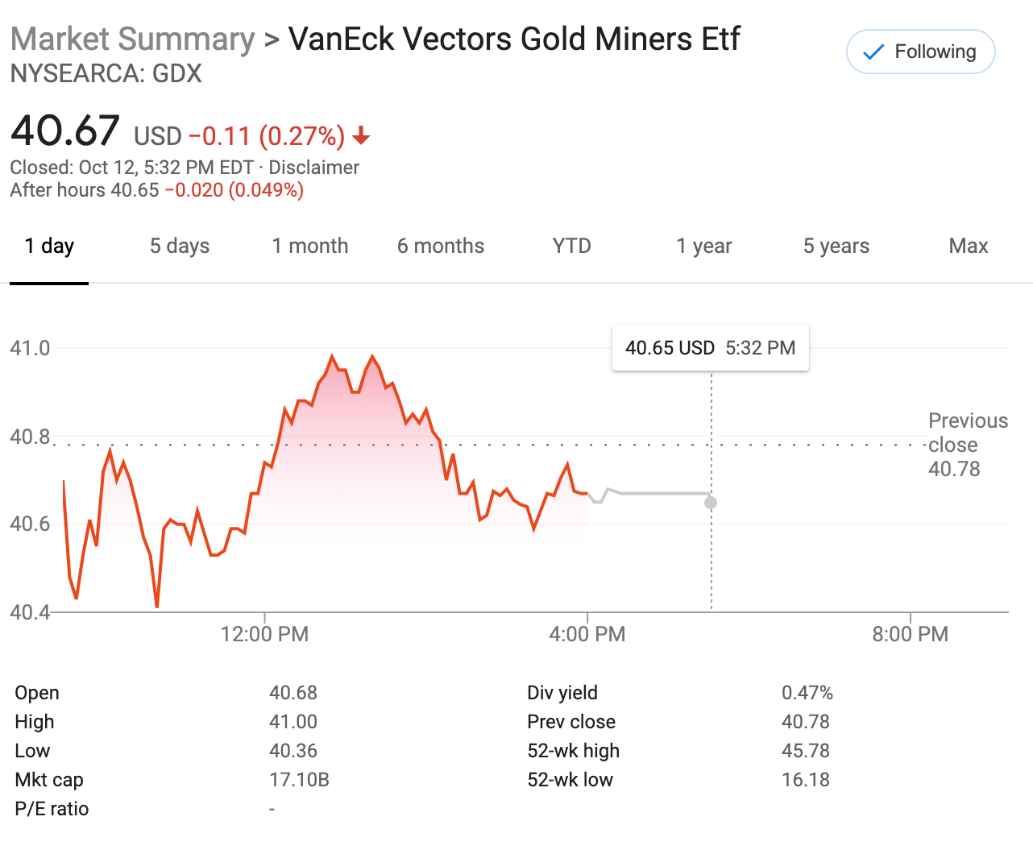
Data Description
The dataset is from yahoo finance historical database.<”https://finance.yahoo.com/quote/GDX/performance?p=GDX
VanEck Vectors Gold Miners ETF (GDX)
1259 sample size
“Date” , “Open” , “High” , “Low” , “Close” , “Adj.Close”, “Volume” . “Nextday”, “Profit_In_Percentage”, “Month” ,“Year” .

Slide 5
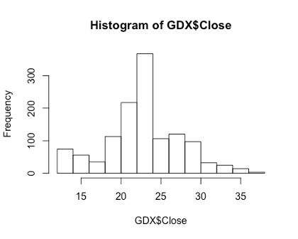
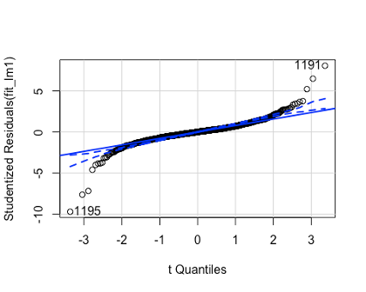
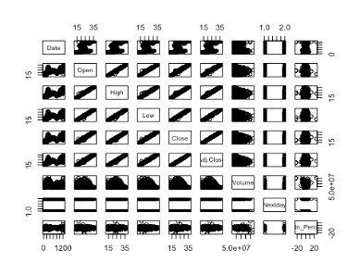
Data Diagnostics
No empty values
Outlier appears
Close to normal distribution
High correlation

Slide 6
Data Analysis and Main Results
The question I want to analyze is: what is the closing price of the stock the next day? Short-term predictions of whether it will go “up” or “down” tomorrow.
Long-term forecasting to understand what time should buy and sell.
Using data visualization to check and understand data central trends and outliers.
PCA,LDA,QDA was performed to understand that account for most of the variation in the variables and to predict whether the stock would go ‘up’ or ‘down’ for the next day, as well as to predict what the stock will performance in the future for long-term.
Notes:
The preliminary analysis
The question I want to analyze is: what is the closing price of the stock the next day? Short-term predictions of whether it will go “up” or “down” tomorrow. Long-term forecasting to understand what time should buy and sell. In the field of big data, data visualization tools and technologies are critical to analyzing massive amounts of information and making data-driven decisions. In this analysis, I will use data visualization to check and understand data central trends and outliers.
The closing price of a stock can be predicted by establishing a regression model,however,the real value is far away from the model result. Around 25% error rate in the regression model compare with the real closing price. Principal Component Analysis is usful when variables are highly correleated. In the further analysis, I will use PCA to understand that account for most of the variation in the variables. In addition, I will Logistic Regression, Decision tree to predict whether the stock would go ‘up’ or ‘down’ for the next day, as well as to predict what the stock will performance in the future for long-term.
By establishing the analysis and comparison of three linear regression models, the closing price of the stock in the final model is taken as the corresponding, and the opening price and trading volume are used as the predictors. Dataset is devided into two parts for training and testing respectively, 50% of which was used for training data, and the other 50% was used for testing the output accuracy.The outlierTest indicate that there are few points are extrem large, I will simply drop these points in the analysis to get better understanding of the real situation. An analysis of variance hypothesis test that compares the quality of fit for the linear model stored in the respective variables ‘fit_lm’,‘fit_lm1’ and ‘fit_lm2’. The calculated F-Statistic and associated p-value from the generated ANOVA table indicates that the multiple linear regression model “lm(Close~ Open + Volume , data = GDX)” is better at predicting ‘Close’ versus the more variables in multiple linear regression model. The bar chart display the total days of Decrease and Increase from 2015 June until 2020 June.

Slide 7
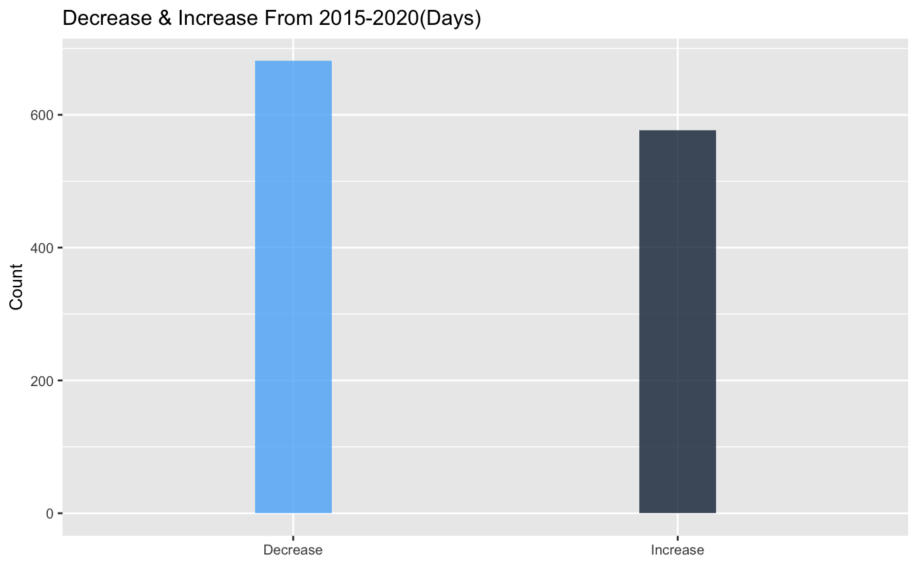
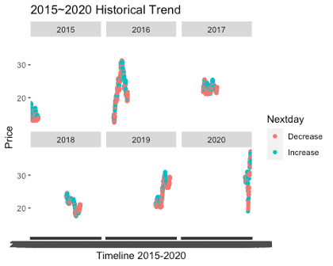
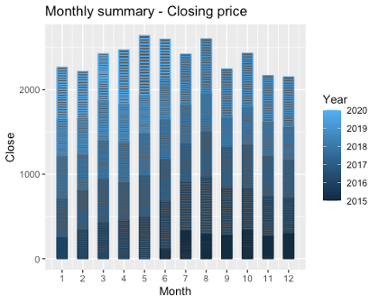
Data Visualization
Figure 1
Figure 2
Figure 3

Slide 8
Generalized Linear Model
From Generalized Linear Model we can see that the closing price of a stock can be predicted by establishing a regression model, however, the real value is far away from the model result. Around 25% error rate in the regression model compare with the real closing price. I used the model generated on the training set to predict outcomes for our validation set and calculated the test error rate, or the percentage of time the model misclassified an outcome as compared to the observed results. In general, linear regression analysis does not seem to be suitable for predicting stock prices.
I use logistic regression to estimate that the model correctly predicted that the market opening price order to go up on 13 days and that it order to go down on 669 days, for a total of 669 + 13 = 682 correct predictions. Among them, the error rate reaches 1-0.5421304=0.4578696, which means the error rate of logistic regression is about 46%. According to the observation, we can know that the Generalized Linear Model is not very accurate in predicting stocks.

Slide 9
Linear Discriminant Analysis
Now we will perform LDA and QDA for classification analysis. Here again I used split dataset into training and validation sets and fit LDA and QDA model to training set. Linear Discriminant Analysis corrected predict 666 days market went done and 11 days market go up. The LDA output indicates that ˆπ1 = 0.5488 and ˆπ2 = 0.4512; In other words, almost 55% of the training observations correspond to days during which the market went down, nearly 45% error rate in the model,the prediction accuracy is 55% .

Slide 10
Quadratic Discriminant Analysis
Quadratic Discriminant Analysis corrected predict 548 days market went done and 127 days market go up. The QDA output indicates that ˆπ1 = 0.5488 and ˆπ2 = 0.4512; ˆπ1 and ˆπ2 outPut are same as LDA. Also nearly 54% of the training observations correspond to days during which the market went down, nearly 46% error rate in the model,the prediction accuracy is 54% .

Slide 11
After compare three model, We can see the LDA,QDA and logistic regression predictions are almost identical.
LDA - Prediction Accuracy is 55% .
QDA - Prediction Accuracy is 54% .
Logistic Regression - Prediction Accuracy is 54% .

Slide 12
Principal Component Analysis
The rotation matrix provides the principal component loadings; each column of pr.out$rotation contains the corresponding principal component loading vector, we see that there are six distinct principal components. The standard deviations for six distinct principal components are : 2.25, 0.96, 0.08, 0.04, 0.04, 0.02. After I compute the proportion of variance explained by each principal component, it indicates that the first principal component explains 85% of the variable in the data, and the next principal component explains 15% of the variance, and the rest of other principal component explains almost 0% of the variable. Meanwhile, we know that first two component are contains most of the variable in the data.

Slide 13
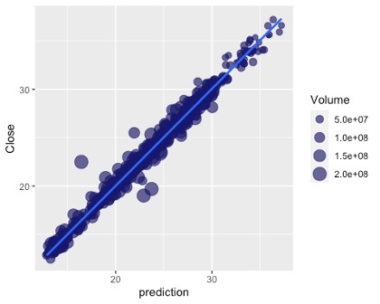
Conclusion and Future Research
Insight gain
2015 - 2020 shows an average daily rise and fall of -0.9% to 0.97%
Short-term investment in this stock is not an ideal strategy
November and December are low buying times
Future Research
Other creative and effective methods
Model can be modified
Study the short selling mechanism

Slide 14
Video Link for the presentation
https://uri.techsmithrelay.com/YTFc

Slide 15
Thank you!

